Slide 2
Thank you for joining the TSB Business Speaker Series
All participants will be on mute
Questions can be submitted through the Q&A Feature – please add your email address at the end of your question
With over 500 participants today we will not be able to answer all questions during the session, but will try to follow up after the meeting if we don’t get to your question.
Our purpose today is to try to SIMPLIFY what looks like a daunting application
For additional support after the presentation
Your Bank Relationship Manager
Your Accountant/CPA
Your Payroll Service Provider

Slide 3
PPP Forgiveness Workflow for TSB Clients
Borrower gathers all required supporting data
Borrower logs in to TSB Portal
Download and complete SBA Forgiveness Application. Save to portal.
Upload required documentation for 1)Payroll Costs 2) Non Payroll Costs 3) FTE Calculations
Bank prepares forgiveness submission to SBA
Bank submits to SBA E-Tran for approval
Bank notifies customer of action
Bank receive forgiveness funds from SBA and applies to borrower’s loan
Calculate payments payment based on remaining loan balance, notify borrower, and update system
Bank receives notice of approved forgiveness amount from SBA
Borrower pays out remaining loan balance over 18 months (beginning Nov)

Slide 4
SBA Loan Forgiveness Application
For PPP Borrowers with Texas Security Bank
TSB clients will receive an email that will include
TSB Loan Number
SBA Loan Number
PPP Loan Amount
PPP Loan Disbursement Date
URL for TSB Portal
Log in to Https://TexasSecurityBank.marqportal.com
Create UserID and Password
Download and complete the SBA Loan Forgiveness Application
Save completed application to portal
Upload all required supporting documentation to portal
Recognize that the entire loan may not be forgiven and that there could be some remaining obligation for the borrower to repay.
For loans greater than $2MM the SBA will audit Loan Forgiveness Application

Slide 5
Getting Started - Dates To Know
1st Day of 1st Pay Period After Funding
8 Weeks (56 Days)
Alternative Payroll Covered Period
Date Loan Funded
90 Days
Filing Deadline for Forgiveness Application

Slide 6
Important FTE Numbers
Employees | Total
FTE’s as of Feb 15, 2020
FTE’s as of Date of Loan Application
FTE’s as of Date of Forgiveness Application
Average FTE’s During Covered Period or Alternative Payroll Covered
FTE’s as of End of Covered Period or Alternative Payroll Period
FTE’s on June 30, 2020
Average FTE Feb 15, 2019 thru Jun 30, 2019 (Base Period)
Average FTE Jan 1, 2020 thru Feb 29, 2020 (Base Period)

Slide 7
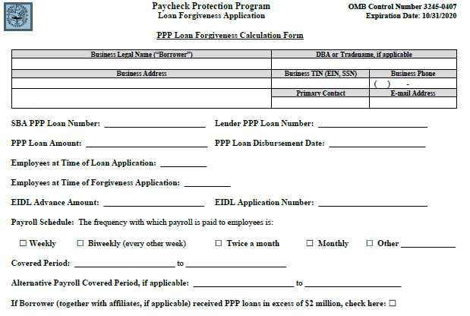
Loan Forgiveness Calculation Form (Page 3)

Slide 8
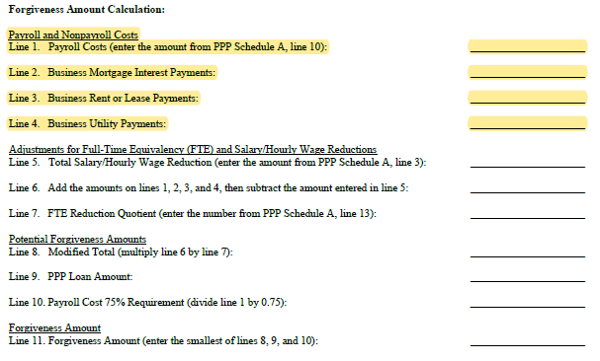
Loan Forgiveness Calculation Form Payroll and Non-Payroll Costs

Slide 9
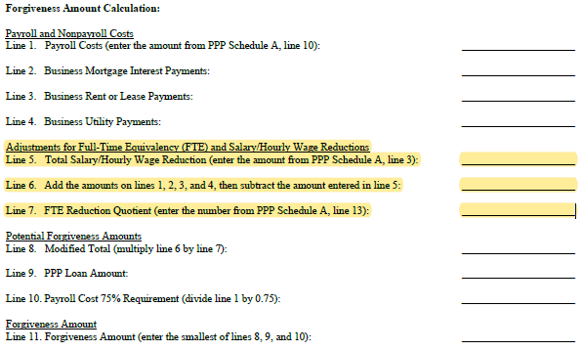
Loan Forgiveness Calculation Form Adjustments for FTE and Wage Reductions

Slide 10
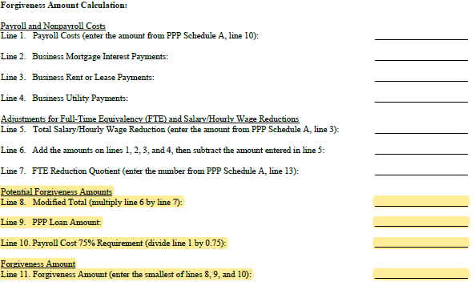
Loan Forgiveness Calculation Form Forgiveness Calculation

Slide 11
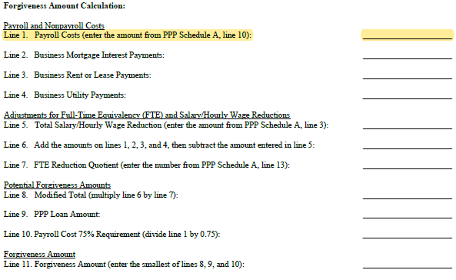
Calculate Payroll Costs

Slide 12
Payroll Costs
Payroll costs can include:
Gross Salary, Wages, Commissions
Cash tips or the equivalent (additional wages paid to offset decline in tips)
Payment of vacation, sick, parental/family/medical leave
Employer payment of retirement contributions and group health coverage premiums
State and local taxes assessed on payroll
Refinancing of EIDL loans that were used for payroll
Costs paid during Covered Period and costs incurred during Covered Period but not yet paid

Slide 13
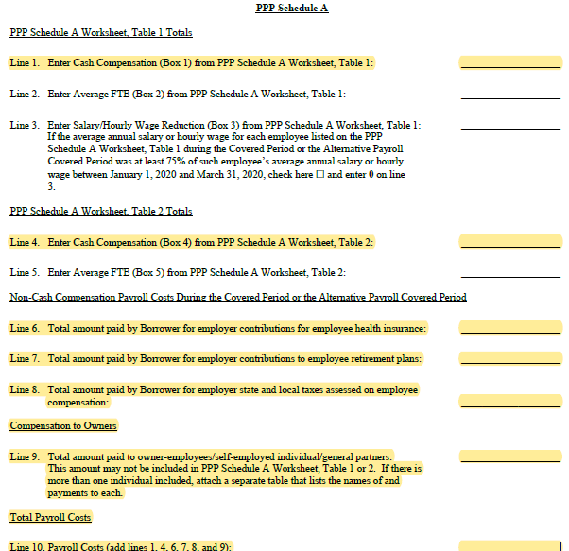
Payroll Costs – Sch A (page 6)

Slide 14
Payroll Costs
Items NOT INCLUDED in defined Payroll Costs:
Employer paid federal payroll tax, including employer’s share of FICA
Compensation paid to employees in excess of $100,000 annualized
Compensation paid to employees domiciled outside of the U.S.
Amounts paid to independent contractors

Slide 15
Payroll Documentation
Form 941
State quarterly wage unemployment insurance tax reporting forms
Your internal payroll records or equivalent payroll processor records
Group insurance and retirement contribution statements – along with payment receipts or cancelled checks
Records of transfer from PPP Funds (if using a separate account) to payroll account or processor

Slide 16
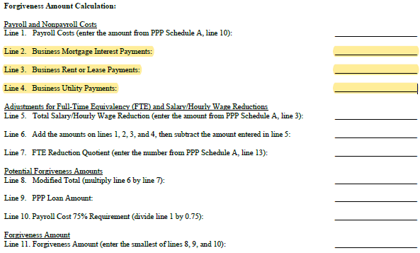
Non Payroll Costs

Slide 17
Non-Payroll Costs
Use of PPP Funds on the following expenses during the measurement period will also qualify for forgiveness (up to 25% of the PPP forgiveness):
Mortgage interest payments on obligations, for real and personal property, existing prior to 2-15-20 (does not include prepayments or principal payments)
Business rent or lease payments (on leases for real and personal property in force prior to 2-15-20)
Utility Payments on contracts created prior to 2-15-20. Covers electricity, gas, water, transportation, telephone, internet
Costs paid during Covered Period and costs incurred during Covered Period but not yet paid

Slide 18
Non-Payroll Documentation
Proof of business rent paid (cancelled checks etc)
Copy of leases and loans
Utility bills and payment records
Note and Interest statements or amortization schedules for mortgage interest

Slide 19
Loan Forgiveness Calculation Form Adjustments for FTE and Wage Reductions

Slide 20
Reductions in Compensation in Excess of 25% for Any Individual Whose 2019 Compensation was Less than $100,000
The total amount of such compensation reductions over 25% during the Covered Period would be subtracted from the calculated Forgiveness Amount.
25%

Slide 21
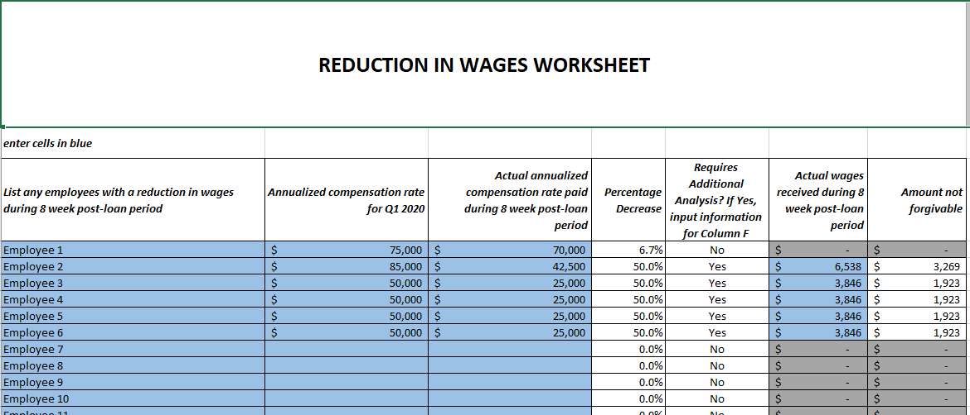

Slide 22
Forgiveness Amounts May Be Reduced Based on Reduction in Employee Headcounts or Salary Reductions of 25% or More for an Individual Employee
Employee Headcounts: | Total
CURRENT AVERAGE FTE During the 8-week Covered Period (A) | 25
BASE AVERAGE FTE During the period 2-15-19 thru 6-30-19 (B) | 30
BASE AVERAGE FTE During the period 1-1-20 thru 2-29-20 (C) | 32
The borrower can choose to use either line B or C as its BASE PERIOD FTE number
Let’s run an example using B. If the borrower had 30 FTE During the Base Period and currently has 25 FTE, the math would look like this:
In this case the calculated forgiveness amount would be reduced by 16.67%
(AVG FTE COVERED PERIOD)/BASE PERIOD AVG FTE = FTE Reduction Quotient
25 / 30 = 83.33%

Slide 23
FTE Reduction Calculation –Sch A (Page 6)
.

Slide 24
Safe Harbor - Reductions Eliminated
The reduction of Forgiveness Amount as described above can be eliminated if by no later than June 30, 2020, the employer hires back to it Base FTE Level (app uses a date of 2-15-20)
Not considered a reduction if good faith offer to rehire was not accepted
FTE may include positions filled by new employees
Restores pay reductions back to the average 2019 levels.

Slide 25
Loan Forgiveness Calculation Form Forgiveness Calculation

Slide 26
Ways to continue your journey as a Champion of Free Enterprise:
Engage with our TSB Community
Follow us on LinkedIn: https://www.linkedin.com/company/texas-security-bank/
TSB Academy 2020- Join our new class beginning September 2020
For more information: https://www.texassecuritybank.com/about-us/tsb-academy/
SBA Disaster Relief
Find Resources here: https://www.texassecuritybank.com/sba-disaster-assistance/
Give us a 5-Star rating on Google!

